Slide 1
UAV SWARM
Guided by: Dr. K.Raghavendra (Scientist ‘SG’, ADRIN (ISRO))
1602-20-737-036 K SAI SHRUTHI
1602-20-737-036 DOODALA AKSHITHA
1602-20-737-017 JIBA NAFEES FATHIMA

Slide 2
Agenda
Objective / Goal
Proposal
Hardware and Software(s) Requirements
Design Flow
Architecture
Use Case Diagrams
Hardware Interfaces - UAV/Drone
Sample Screens
Demo Video
References
Conclusions and Future Scope

Slide 3
Objective/Goal
Usually the drones/UAVs are controlled using Joystick(Remote Controller-RC) or Ground Control Station one at a time. However, controlling a group/swarm is really a challenging/daunting task as it needs more numbers of RCs / Ground Control Stations.
To overcome this issue, proposed to build IOT controlled Software and hardware system for swarm of drones using GPRS/Cellular Communication.

Slide 4
Proposal
Design and development of Swarm UAV system using Cellular (GPRS) communication and Edge Computing (IOT) devices.
Use of DroneKit - Python SDK for UAV Programming.
Design of Graphical User Interfaces(GUI) for sending and receiving messages from Ground Control Station/Laptop to the IOT board(Raspberry pi).
Testing the Swarm setup in lab environment for one UAV and subsequently extend to 8 numbers.

Slide 5
HARWARE REQUIRED
Raspberry pi 4 : IoT Device
Pixhawk : Flight Controller
LAN cable/ GPRS modem : Communication Equipment
SIM card : Cellular Communication
Drone/UAV : Vehicle
Ground Control Station(GCS)/Laptop : Ground Controller

Slide 6
SOFTWARE REQUIREMENTS
Python 3.10.8 –
1. Tkinter- GUI design
2. Socket Programming- Communication
Drone Kit- SDK for UAV programming
Zero Client- VPN public IP

Slide 7
Work / Design Flow
Connect OS installed raspberry pi to Pixhawk (Flight Controller)
Check the connections for single drone.
Install Zero-Tier: Zero-Tier creates secure networks between on premise, cloud, desktop to connect team members around the globe.
Zero tier provides an IP address to both raspberry pi (Client address) and our laptop (Server address).
Finally, Communicate with the drone to Tkinter GUI to perform Basic operations like:
i.Arm
ii.Disarm

Slide 8
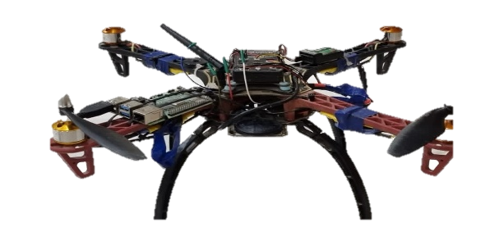
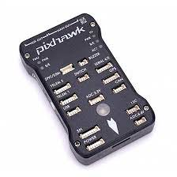
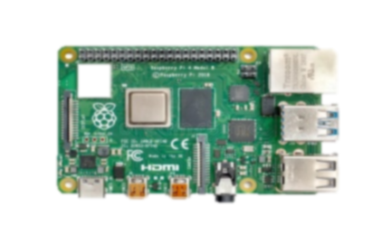
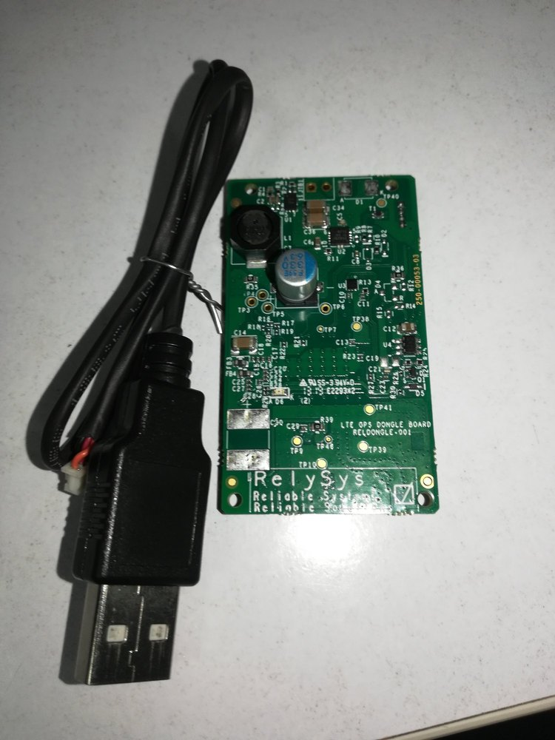

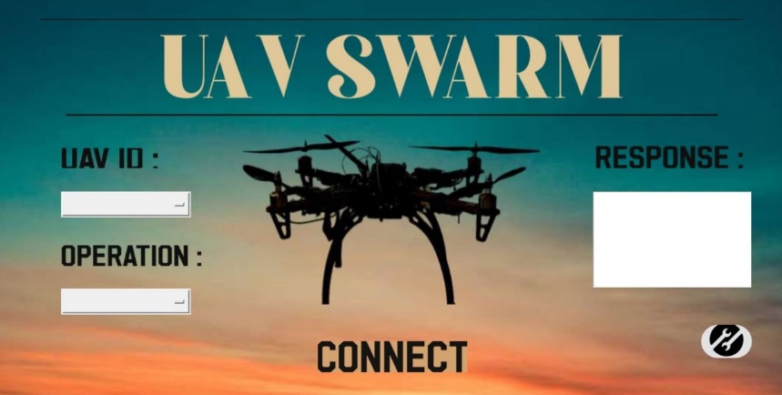
ARCHITECTURE
UAV
TELEM1
Raspberry Pi
Connecting IOT board and flight controller
Through TELEM2
Flight Controller
USB
TELEM2
GPRS
4G USB Cellular Modem
GUI for sending and receiving messages from GCS
Cellular Communication
Socket Program
Software providing public IP address to the IOT board and GCS

Slide 9
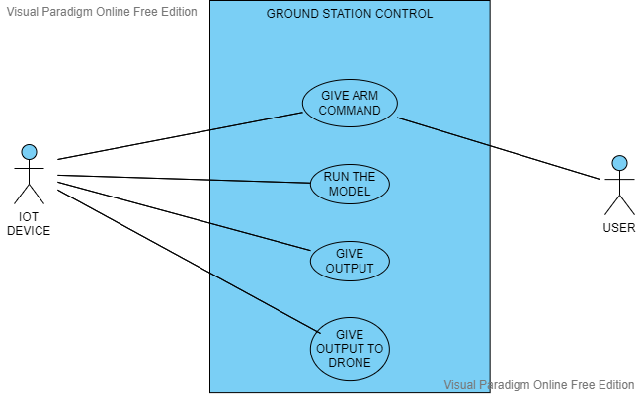
USECASE DIAGRAM

Slide 10
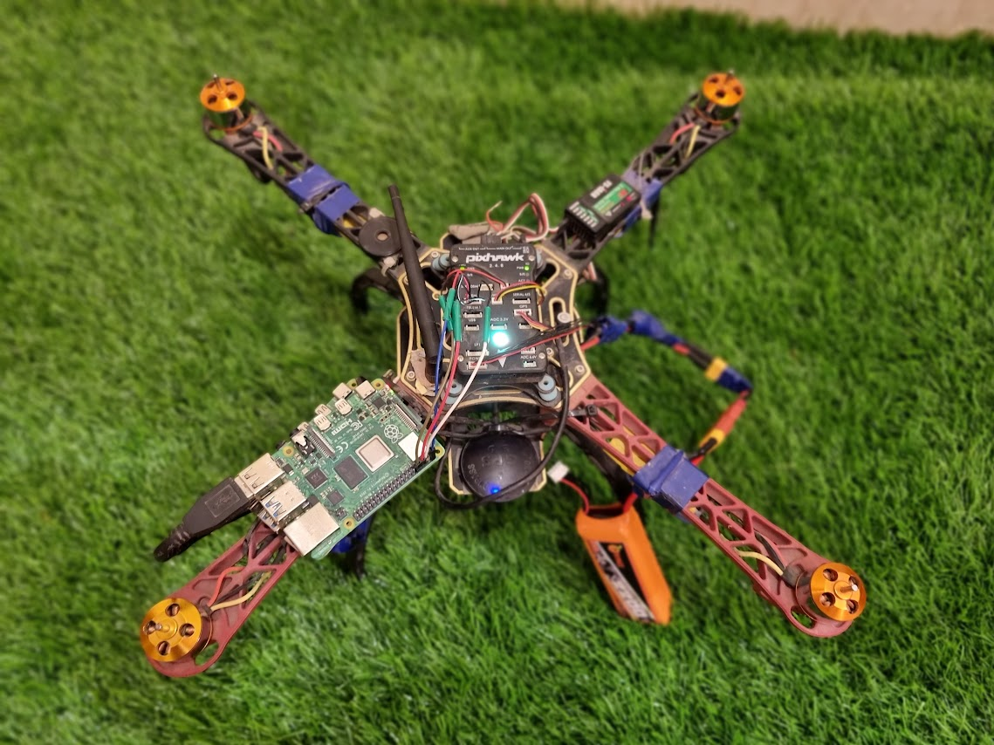
HARWARE Interfaces
JoyStick Receiver
Flight Controller
Raspberry Pi and GPRS Modem
GPS

Slide 11
Sample Screens

Slide 12
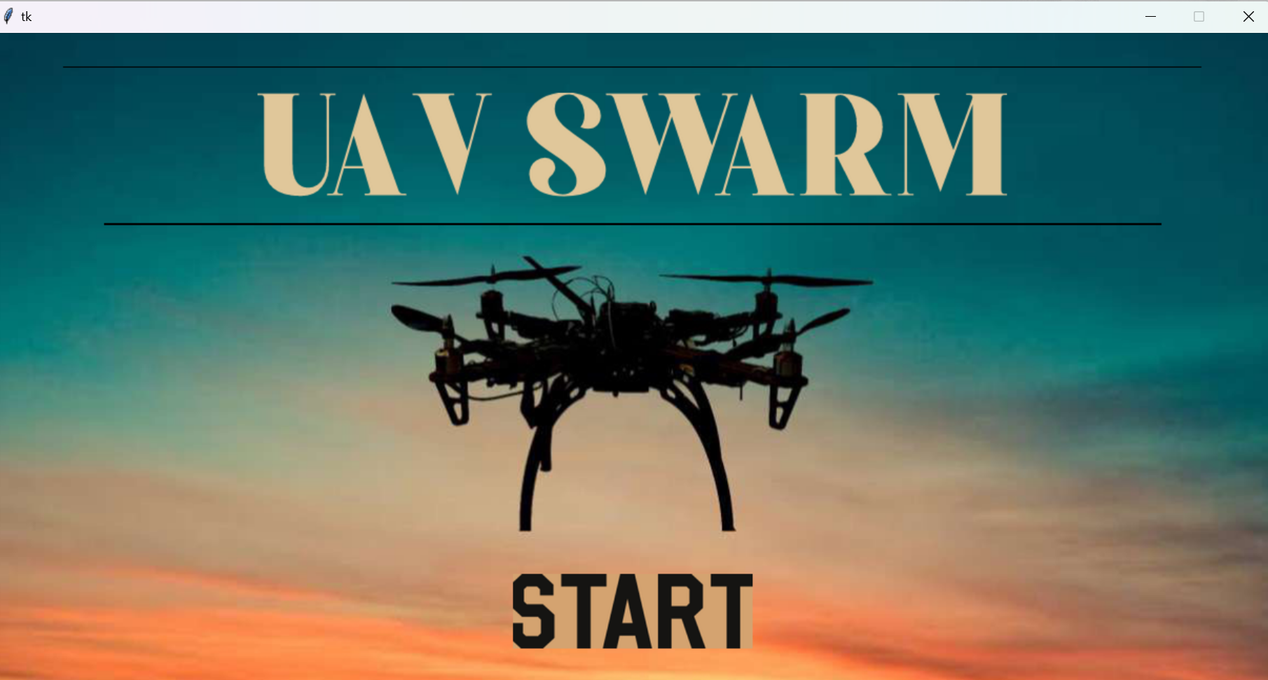
Graphical User Interface (GU)

Slide 13
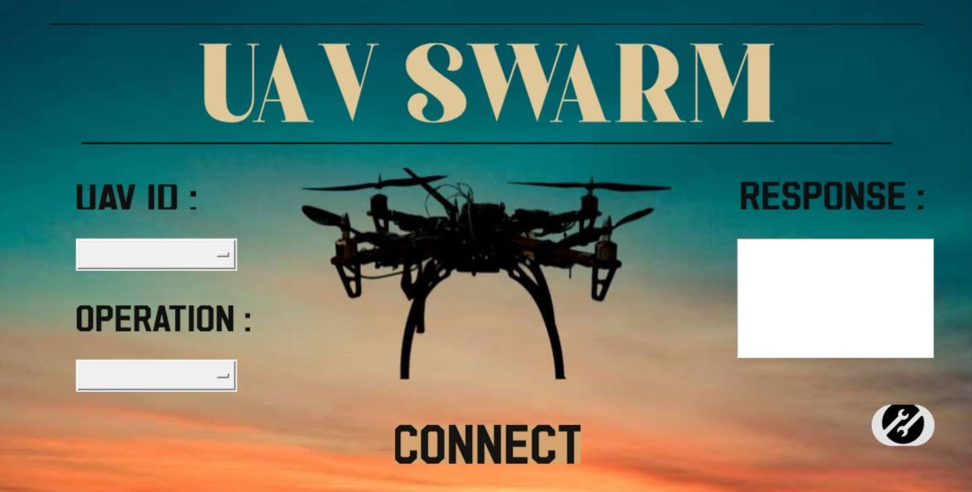
GUI

Slide 14
Sample Outputs

Slide 15
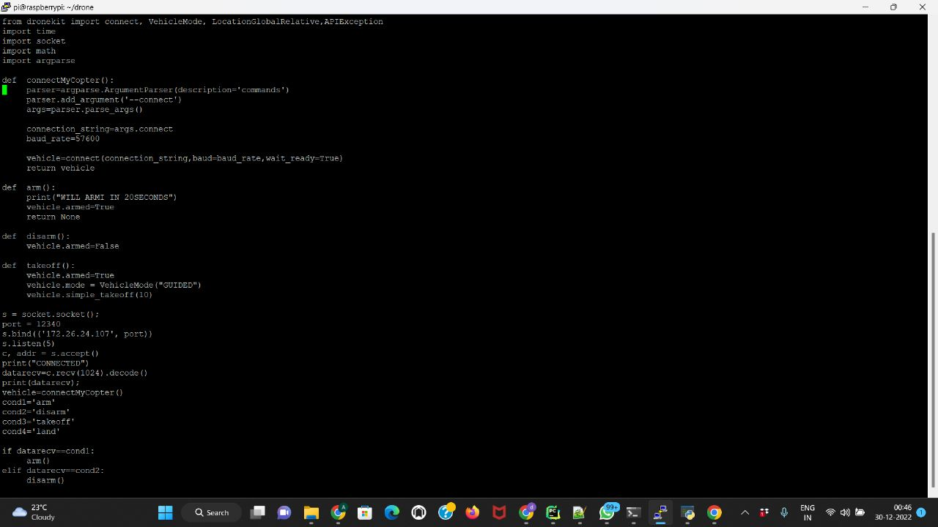
ARM –(DRONEKIT CODE)

Slide 16
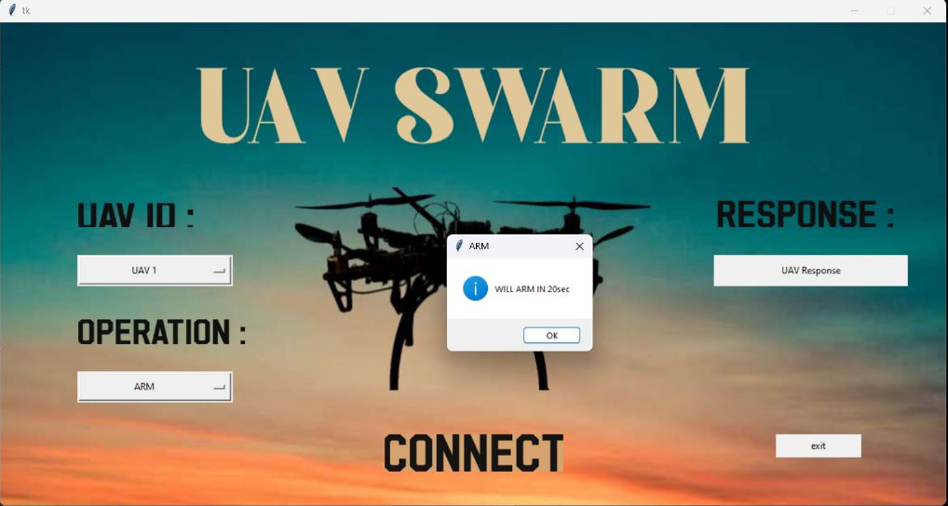
OUTPUT

Slide 17

OUTPUT

Slide 18
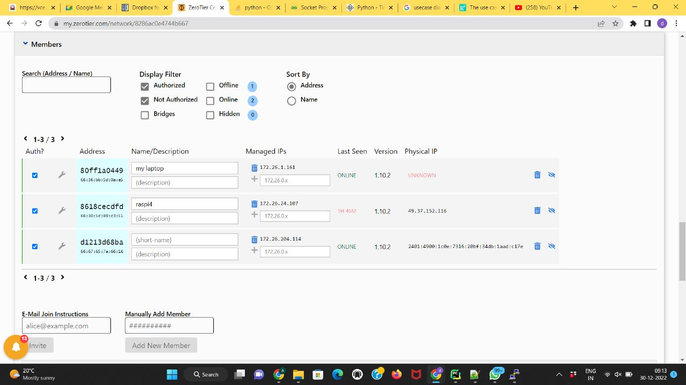
ZERO CLIENT – Public VPN system
GCS Public IP
RPI Public IP

Slide 19
Demo Video

Slide 20
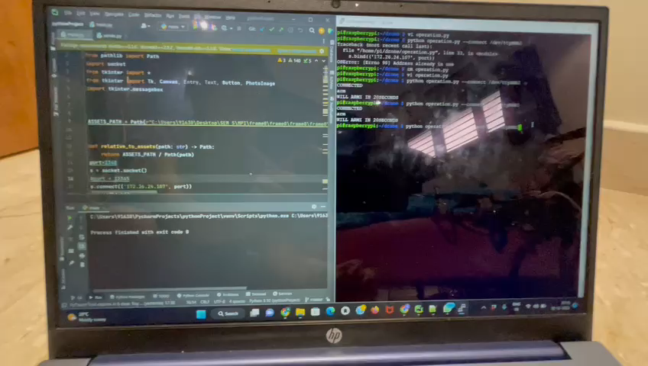
Sample Video – Command and Control through GPRS, DroneKit and Client-Server Program

Slide 21
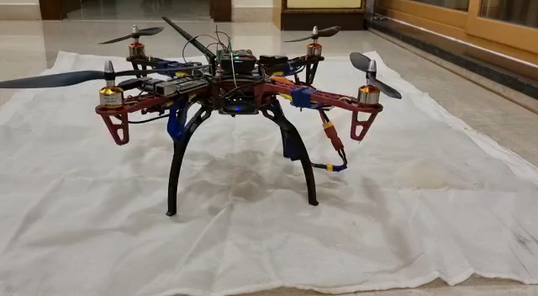
UAV/Drone

Slide 22
REFERENCES:
https://dronekit-python.readthedocs.io/en/latest/develop/sitl_setup.html
https://dronekit.io/
https://www.raspberrypi.org/
https://www.youtube.com/watch?v=CUEbTx1Fh1w
https://youtube.com/playlist?list=PLgiealSjeVyx3t4N9GroE29SbVwhYrOtL

Slide 23
Conclusions & Future Scope
The UAV SWARM project can be extended to have an advanced Graphical User Interface and can be tested with more real-time UAVS to use for drone light show or any other applications.
The software developed should further be able generate a pattern for simulating a swarm of drones.
Display of UAV/Drone Locations on the backdrop of map , as an extension to GUI
Extended the Dronekit and Client/Server (Socket Program) to handle multiple UAVs asynchronously.

Slide 24
THANK YOU

